Slide 1


NEAR FIELD COMMUNICATIONS
THE NON-RADIO BITS
Tom Keetch
DC4420, Tuesday 24th June 2014

Slide 2
Who Am I?
  Tom Keetch
  Security Researcher for BlackBerry
  Interested in:
    OS Security
    Exploit Mitigation (esp. Sandboxes)
    Browser / web app security.
    Recently: FPGAs…
Notes:
Recently been playing around with LTC mining using FPGAs, interested in chatting to people about that.
This presentation is based on experiences during the development of BlackBerry OS 10 over the past 2 years.
There are some restrictions on what I can say. E.g. no dropping 0h day, my employer wouldn’t be keen on that.

Slide 3
Outline
  NFC Re-cap
  Tags
  Operating Modes
  Secure Element
  Host-based Card Emulation
  Conclusions
Notes:
Premise: There’s more to NFC than just radio, focus on secure element security.
45mins – 1 hr. Can take questions at any point.

Slide 4
NFC RE-CAP

Slide 5



What is NFC?
  Near Field Communication
  Short Range Communication
    Typically 0-5 cm
    Specialized antennae will test this assumption
  Transaction initiated by a “tap”, signals intent
  Used in contactless payments, transport
  Was fashionable for security research circa 2012
Notes:
Tony did an introductory talk on NFC a few months ago, but here’s a quick refresher on NFC.

Slide 6
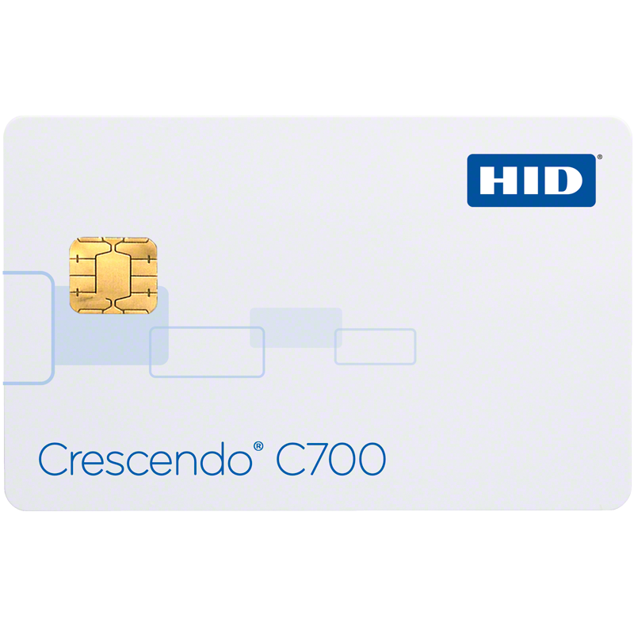
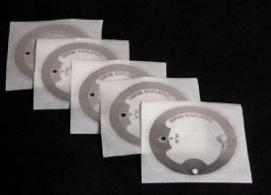
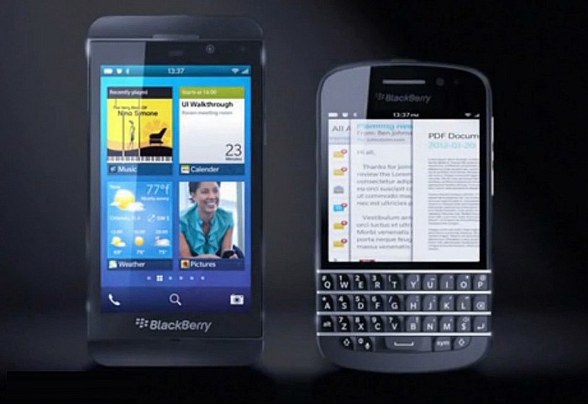
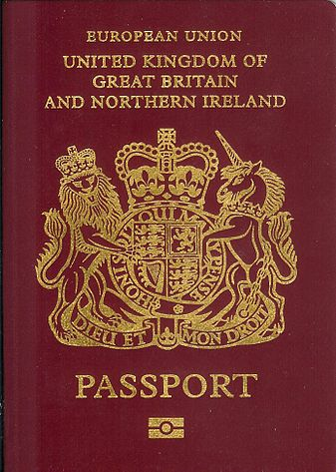
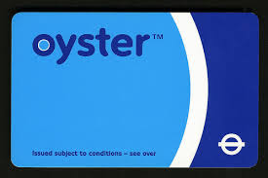
NFC Form Factors
Notes:
Tags – store a small about of data and spit it out when charged by a reader
Smart cards – new contactless interface added e.g. building access cards and bank debit cards
ICAO Passports - as someone pointed out to me recently, Electronic Passports use standard NFC as opposed to a proprietary RFID.
How these work is that certain machine readable data inside the passport is used to authenticate over NFC and then read the full passport contents.
The problem is that the machine readable data is somewhat predictable e.g. date of birth and vulnerable to brute force.
Oyster cards – Pretty much everyone here (in London) will have one.
Mobile Phones – Implement a superset of everything else…

Slide 7
NFC vs. RFID
125kHz
P2P
Tag Read/Write
134.2kHz
NDEF
Card Emulation
433 MHz
2.45GHz
13.56MHz
Global Platform
5.8GHz
Notes:
NFC is continued evolution of RFID technology. Lots of proprietary RFID solutions that can now be implemented in an “NFC-compliant” way.
RFID provides the physical and transport layers for NFC.

Slide 8


Effective NFC Range
~1.5m
~15m
Mallory
Eve
Bob
Eve
  Data Source: Renaud Lifchitz, HES 2012 [1]
Notes:
Since limited range is a security property of NFC, the maximum effective range is very important, here are some figures taken from a 2012 presentation.
Eve is a passive attacker, trying to snoop on the (unencrypted) NFC/RFID transaction.
Mallory is an active attacker trying to solicit an NFC “tap” from the card.
Ranges taken from http://2012.hackitoergosum.org/blog/wp-content/uploads/2012/04/HES-2012-rlifchitz-contactless-payments-insecurity.pdf
It’s interesting to consider the relative cost of the equipement vs. the value of the NFC transaction. In the case of contactless payments, the maximum transaction is ~£25, so using £2000 worth of equipment and getting that close probably isn’t economically viable for an attacker. But attacks only get better…

Slide 9
NFC TAGS

Slide 10
TAG Types
  There are 4 standardised Tag Types - Why 4?
  Conflicting implementations – standardise them all!
  Basically
    Types 1 & 2 – Simple Low Memory Tags
    Type 3 – Japanese Tags (e.g. FeliCa)
    Type 4 – Smart Card interface
  Type 2 is most commonly used with Mobile Phones
  All data encoded in NDEF
Notes:
NDEF = NFC Data Encoding Format

Slide 11
MiFare Classic
  The old TfL Oyster cards used MiFare Classic
  Not part of the NFC standard
  It used proprietary secret cryptographic algorithm...
  …which was badly broken (?!!) [2]
  Newer Oyster Cards use DESfire – Type 4 NFC cards

Slide 12
Tag Threats
  Malformed Tags
    Charlie Miller – Exploring the NFC Attack Surface [3]
  Malicious Tags
    tel://premium-rate-brazillian-phoneline/
    Vulnerable 3rd Party URI Handlers
  Over-written / replaced tags
    Tags in public places might not be write protected
    Or might otherwise be physically substituted.
Notes:
Taping a tag or reader is much like clicking a shortened URL in terms of security risks.

Slide 13
NFC Modes

Slide 14
NFC Modes
  Reader Mode
  Tag/Card Emulation – a device pretends to be a passive device
  Peer-to-Peer
    Simple NDEF Exchange Protocol (SNEP)
      NDEF Based
    Logical Link Control Protocol (LLCP)
      Connection Based

Slide 15
Handover
  If transferring a lot of data, like a large file, NFC isn’t suitable
  Therefore NFC supports handover to other transports:
    Bluetooth (a.k.a. Android Beam)
    WiFi Direct (a.k.a. S-Beam)
    Bluetooth LE (?)
  Uses tag emulation to present a handover NDEF record
    Contains pairing information for temporary pairing
    Handover technologies are part of NFC attack surface…

Slide 16
NFC SECURE
ELEMENT

Slide 17
What is the Secure Element?
  Fancy name for a Contactless Smart Card
  Hosts Applets available over NFC and to local apps
    Provides hardware security for applets
    A more secure execution environment than commodity hardware
  Communication via APDUs over a serial interface
    Client asks to speak to an application based on an Application ID (AID)
    Communication is Command-Response
Notes:
Applets are the applications that run on the Secure Element / Smart card.

Slide 18
Applets on Secure Element
  The Secure Element (on a mobile phone) typicall hosts a number of different applets. For example:
    GSM / LTE Applets
    Payment Applets
    Hardware backed key-storage
  The most common Applet Environment is the JavaCard Runtime Environment (JCRE)

Slide 19
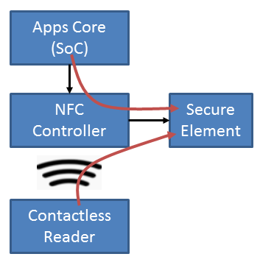
Talking to Applets
  Two interfaces
    Via baseband processor (contactless)
    From apps core
      Via /dev/nfc on BB10
      Via Binder IPC on Android
  An applet can discriminate between the two
Notes:
SoC = System on chip – http://en.wikipedia.org/wiki/System_on_a_chip
The Apps Core refers to where the mobile OS and applications run, as opposed to the modem core / baseband processor.

Slide 20
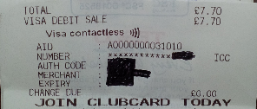

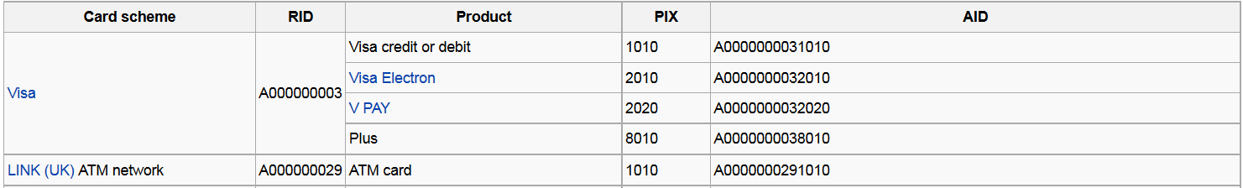
Example: Visa Debit Card
Contactless Payment
ATM Transaction

Slide 21
Types of Secure Element
  SIM Card (UICC)
    Controlled by Mobile Network Operator (MNO)
  Embedded (eSE)
    Controlled by hardware vendor
  microSD based
    Controlled by another third party
    E.g. SecuSmart
  Host-based Card Emulation – pure software
Notes:
Secusmart uses an SD card for secure Voice – used by German government.
Root of trust is controlled by Germany, not by hardware manufacturer (BlackBerry in Canada) or the MNO.

Slide 22
Control of the Secure Element
  A major delay in standardisation and adoption of NFC has been in part due to a tussle between Carriers, Banks and OEMs over control of the Secure Element!
    SE Owner can rent space on SE to applet providers.
    Everyone wants to control the SE!
    Host-based Card Emulation changes this (more later)

Slide 23
Global Platform
  The GP standard defines multi-tenant smart-cards
    Multiple applets from different parties on a single smart-card
    GP version 2.2 designed for mobile devices
  SE is divided into isolated compartments called Security Domains
    A single Issuer Security Domain (ISD)
    Supplementary Security Domains (SSD)
  SE applets managed by a Trusted Service Manager (TSM)
    Each Security Domain could have a different TSM
Notes:
Global Platform also owns the TEE standard, donated by ARM. But TEE doesn’t support Secure Elements…
More Info: http://www.globalplatform.org/specificationscard.asp

Slide 24
Global Platform (cont.)
  TSMs have private encryption keys that allow it manage applets within its associated Security Domain
  Different models for how the TSM operates
    Simple Mode – Issuer does management on behalf of TSM
    Delegated – The SP-TSM has operations authorised by Issuer
    Authorised – The SP-TSM can operate independently
Notes:
TSM operations sometimes referred to as Card Content Management (CCM)

Slide 25
SECURE ELEMENT ACCESS CONTROL

Slide 26
Secure Element Access Control
  Access Control Files (ACF)
    Authenticate Mobile Applications
  Secure Channel Protocol (SCP)
    Authenticate Trusted Service Managers (TSM)
  Contactless Registry Service (CRS)
    Authenticate NFC Readers
Notes:
TSM operations sometimes referred to as Card Content Management (CCM)

Slide 27
Contactless Reader
SCP
SP-TSM
CRS
Secure Element
Issuer Security Domain
Supplementary Security Domain
Supplementary Security Domain
Root TSM
Applet A
Applet D
Applet C
SP-TSM
Applet B
Applet E
ACF
Device
App 1
App 2
App 3

Slide 28
Access Control File
  Steps:
    Check caller is allowed to access the applet
    If allowed: open a new logical channel
    SELECT the requested Applet ID (AID)
    Pass open channel to the client application
  However, the OS needs to filter out certain types of APDU
    Otherwise, the client application can select a new applet, bypassing the access control.

Slide 29
Secure Element
Issuer Security Domain
Supplementary Security Domain
Supplementary Security Domain
Applet A
Applet D
Applet C
Applet B
Applet E
ACF
Device
App 1
App 2
App 3

Slide 30
Access Control File (cont.)
  Controls which applications can access which applets on the secure element
    Signature based
    Implemented/Enforced by the platform
  Only applies to user-installed mobile applications
    E.g. Remove the SIM and place in a reader, ACF not enforced
    Could be bypassed by rooting the device
    Other mechanisms can be used to access SE

Slide 31
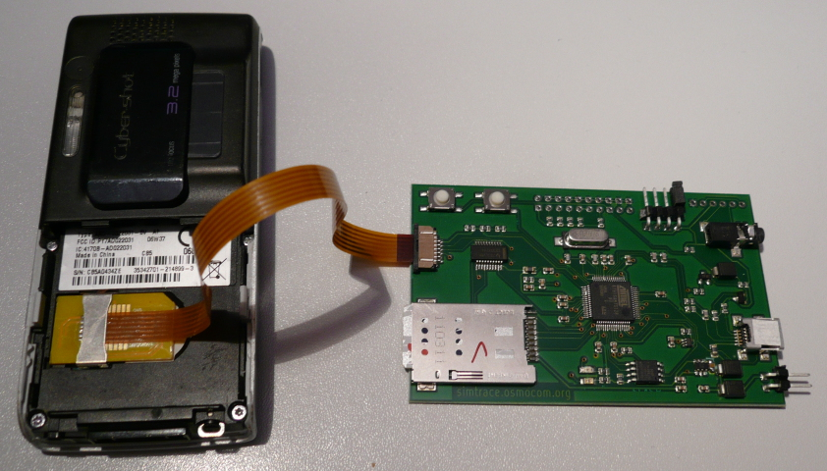
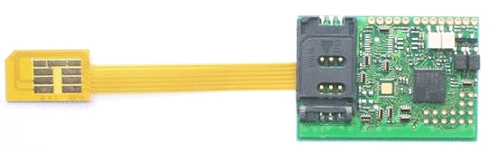
SIM Traffic Interception Tools
  Osmocom SIMtrace - €90
  Bladox Turbo Lite 2 - €49
Notes:
Two Options… I’ve not personally used these, so I can’t recommend them, but others have had success.
1) Osmocom SIMtrace
Costs €90.
http://bb.osmocom.org/trac/wiki/SIMtrace
Can do passive snooping; MITM is possible, but not implemented (AFAIK).
2) Bladox Turbo Lite 2
Costs €49.
http://www.bladox.com/prod_lite_2.php

Slide 32
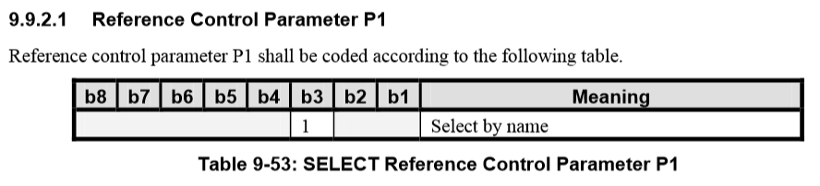
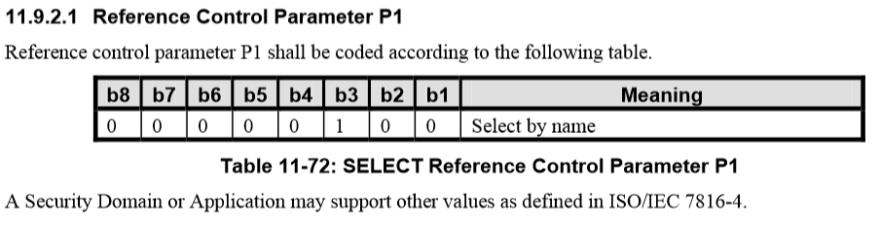
Access Control Ambiguity
Notes:
This shows the encoding of a filtered APDU in different versions of the standard.
Not clear if it’s a flag or an absolute value, but getting it wrong completely breaks the access control model, since you could slip past a SELECT [by name] APDU that should be filtered.
There were two of these checks in the BB10 codebase, both treated it a different way (one as a flag, the other as an absolute value).
I can talk about this bug, because it didn’t affect BlackBerry devices and the problem was resolved a good while ago in GP 2.2. It only affected GP 2.1.1, which no mobile device should be using.

Slide 33
Secure Channel Protocol (SCP)
  Authenticates the Trusted Service Manager
    Creates a secure channel between the TSM and SD
    Mutual authentication
  TSM needs right keys for the SD it’s accessing
  Provides message integrity and sometimes confidentiality
  Unique key per Secure Element
  Unique key per Security Domain

Slide 34
SCP
SP-TSM
Secure Element
Issuer Security Domain
Supplementary Security Domain
Supplementary Security Domain
Root TSM
Applet A
Applet D
Applet C
SP-TSM
Applet B
Applet E

Slide 35
Secure Channel Protocol (SCP)
  Symmetric Key Based (Global Platform)
    SCP01: Deprecated
    SCP02: 3DES-based
    SCP03: AES-based
  PKI Based (Global Platform)
    SCP10: RSA Certificates
    SCP11: ECC Certificates
  OTA Based (ETSI)
    SCP80: SMS
    SCP81: Connection-based
Notes:
SCP02 is most common, smart cards are low power and must resist a wide range of physical and side-channel attacks.
Therefore symmetric crypto is preferred.

Slide 36
Rooting SIM Cards – Karsten Nohl [5]
  Attacking legacy SMS OTA
    Very similar to newer SCP80 standard
    Each SMS is like an APDU
  Many SIM Cards use Single-Key Triple DES
    Cracked using Rainbow tables
    Used to install a malicious applet OTA
  SIM Cards are slow – motivation to use fast symmetric algorithms
  Able to gain “root” on smart card

Slide 37
Contactless Registry Service
  Manages visibility of applets over the contactless interface
    Can be managed directly by user
    Each applet has a user-friendly name and icon
  Mobile wallet can enable/disable:
    Individual applets
    NFC card emulation mode (affecting all applets)
  Allows a single card to be selected for a mobile payment

Slide 38
Contactless Reader
CRS
Secure Element
Issuer Security Domain
Supplementary Security Domain
Supplementary Security Domain
Applet A
Applet D
Applet C
Applet B
Applet E

Slide 39
HOST CARD EMULATION

Slide 40
Host-based Card Emulation (HCE)
  If a Secure Element is unavailable, HCE allows a pure software implementation
  Mobile application can implement Applet functionality
  This gets around the problem of SE ownership mentioned
  Introduced in Android KitKat (4.4)
  Now used by Google Wallet, which no longer supports hardware Secure Elements [6]
    Header Card
    Online transactions only
Notes:
With Host-based Card Emulation, you sacrifice the hardware security provided by the secure element, but you get more flexibility and don’t have to pay any fees to the secure element owner. This opens up many more possibilities for less-sensitive applications, but EMV applets will most likely still want to use a hardware Secure Element.
More info: http://www.nfcworld.com/2013/10/31/326619/google-gets-around-carriers-host-card-emulation-nfc-payments/

Slide 41
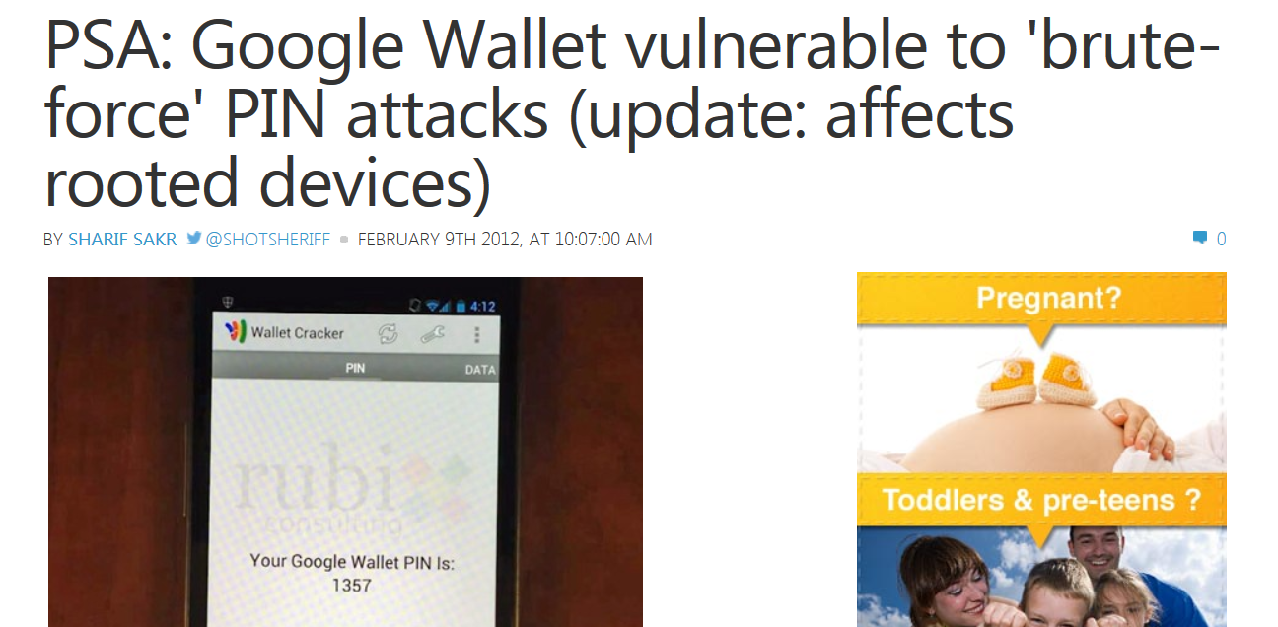
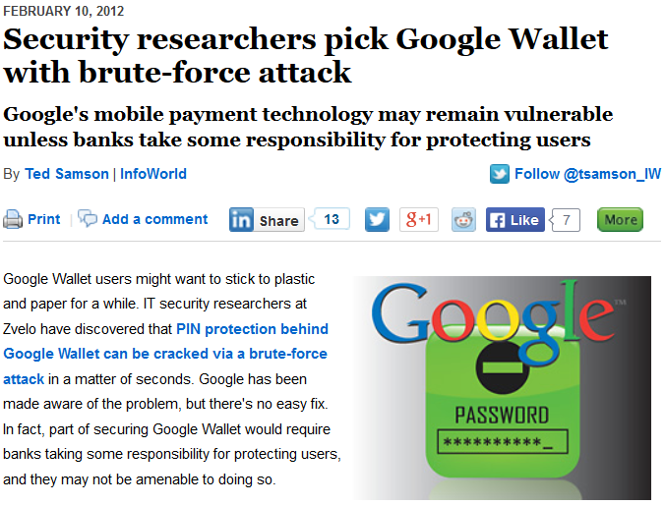
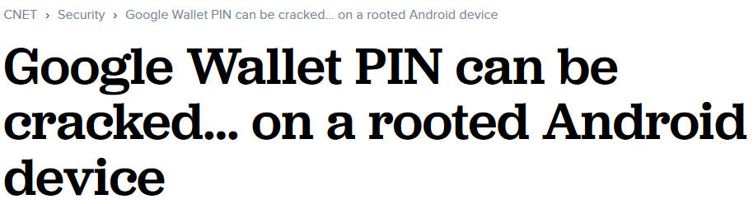
Notes:
The proper way to implement this functionality would have been to do the PIN code check on the secure element, preventing the offline brute force attack. But this would require Google to agree deals with the carriers, since they own and control the secure element.

Slide 42
CONCLUSION

Slide 43
Conclusion
  Hopefully a useful introduction to thinking about the security of mobile NFC applications
  NFC Security is still evolving
    An area with scope for interesting research
  Mobile payments still haven’t hit the mainstream
    Will they ever?
    NFC is still relevant technology in widespread use
  Host-based Card Emulation is a game-changer

Slide 44
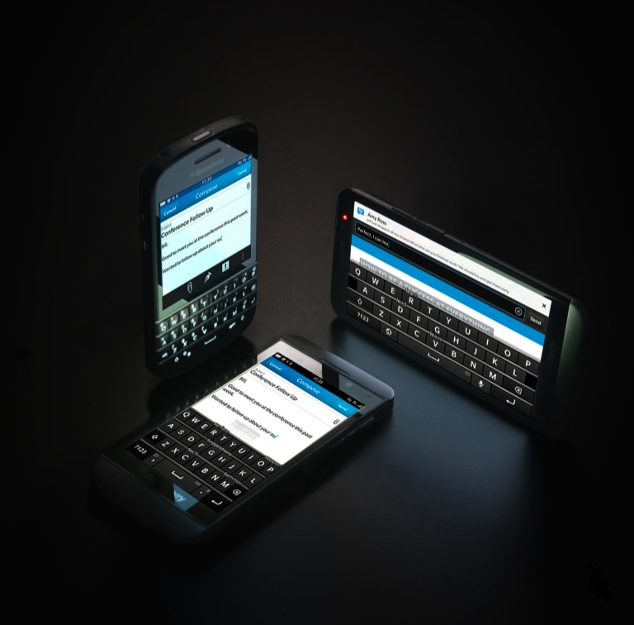
ANY QUESTIONS?
Twitter: @tkeetch
Email: nfc@tkeetch.co.uk

Slide 45
References
  [1] http://2012.hackitoergosum.org/blog/wp-content/uploads/2012/04/HES-2012-rlifchitz-contactless-payments-insecurity.pdf
  [2] www.doc.ic.ac.uk/~mgv98/MIFARE_files/report.pdf
  [3] https://media.blackhat.com/bh-us-12/Briefings/C_Miller/BH_US_12_Miller_NFC_attack_surface_WP.pdf
  [4] http://bb.osmocom.org/trac/wiki/SIMtrace
  [5] https://media.blackhat.com/us-13/us-13-Nohl-Rooting-SIM-cards-Slides.pdf
  [6] http://www.nfcworld.com/2014/03/17/328326/google-wallet-ends-support-physical-secure-elements/
  Further Information
  Android Explorations Blog - http://nelenkov.blogspot.co.uk/search?q=nfc
  Global Platform Standards - http://www.globalplatform.org/specificationscard.asp
  Chip & PIN is Broken - http://www.cl.cam.ac.uk/research/security/banking/nopin/oakland10chipbroken.pdf

